Slide 1
Semiconductor Manufacturing Process
Pass/Fail Prediction using Machine Learning
Team Members: 1) D.Prince Joyal Dhas
2) Arijit Bhunya
3) Supriya Vasudev Kutemate
4) Sumana Hens
5) Theja K
Internship By:- Corizo Edutech Pvt.Ltd
Domain:- Data Science
Submission Date:- 06th April 2026

Slide 2
Introduction
Semiconductor manufacturing involves complex processes
Small variations can cause product failure
Machine learning helps in early prediction
Uses sensor data and Generates large data

Slide 3
Problem Statement
Predict Pass (-1) or Fail (1)
Based on sensor measurements
Reduce defects and improve yield
Improve production quality
Identify important features

Slide 4
Project Objective
We will build a classifier to predict the Pass/Fail yield of a
particular process entity and analyse whether all the features are required to build the
model or not.

Slide 5
Business Insights
High operating pressure increased fault rates by about 18 % onLine A machines; reducing pressure set-points and adding preventive checks should cut defects and downtime.

Slide 6
Recommendations
Adjust the temperature range to 180–200 °C (from 190–220 °C) to reduce thermal stress.
Re-calibrate Machine B weekly using the standard gauge to keep tolerance under ±0.5 mm.
Install a simple IoT vibration/temperature logger with alerts; check logs daily to catch drift early.

Slide 7
Dataset Description
Dataset: sensor-data.csv
1567 samples, 591 features
Target:
-1 → Pass
1 → Fail

Slide 8
Data Cleaning
Dataset contained many missing values
Columns with more than 70% missing values were removed
Remaining missing values were filled using median
Median is robust to outliers
Time column converted to datetime format

Slide 9
Data Analysis & Visualization
Checked data using .info() and .describe()
Univariate Analysis: Histograms for distribution & outliers
Bivariate Analysis: Boxplots to compare features with Pass/Fail
Multivariate Analysis: Correlation matrix using heatmap

Slide 10
Data Preprocessing
Dropped Time column (not useful for prediction)
Dataset was imbalanced
Applied SMOTE to balance Pass/Fail classes
Split data into:
Training set (80%)
Testing set (20%)
Applied StandardScaler
Scaled features to mean = 0, std = 1
Improved model performance

Slide 11
Train-Test & Scaling
Split into training and testing data
Applied StandardScaler
Normalized the data

Slide 12
Models
Logistic Regression (basic model)
Random Forest (ensemble model)
Support Vector Machine (SVM)

Slide 13
Cross Validation
Evaluated models using cross-validation
Reduced overfitting
Random Forest showed strong performance

Slide 14
Hyperparameter Tuning
Used GridSearchCV
Tried multiple parameter combinations
Selected best parameters
Best Random Forest Parameters:
n_estimators = 100,max_depth = None

Slide 15
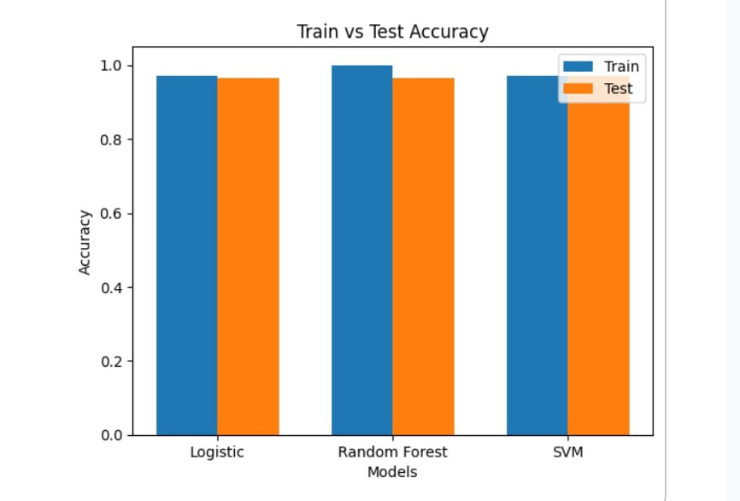
Model Results
Model | Train Accuracy | Test Accuracy
Logistic Regression | 0.97 | 0.965
Random Forest | 1.00 | 0.965
SVM | 0.97 | 0.971
Train vs Test Accuracy

Slide 16
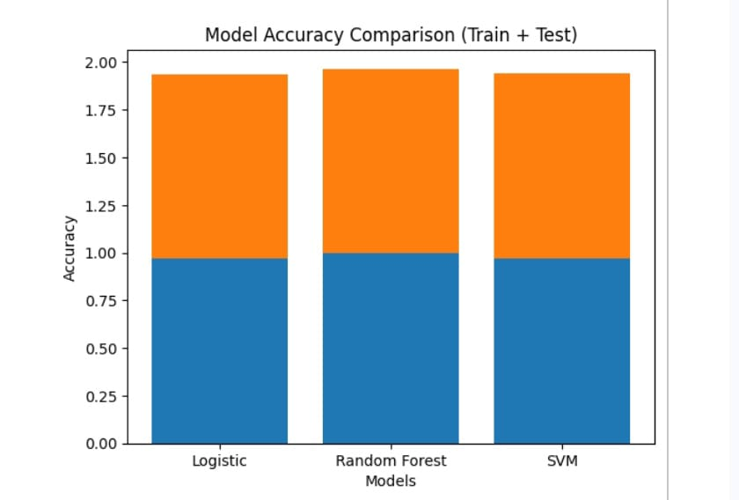
Model Performance
Performance Metrics:
Precision → Correct positive predictions
Recall → Correctly identified actual values
F1-score → Balance between precision &
recall
Model Accuracy Comparison

Slide 17
Comparing Models
From the results, Random Forest performed better compared to other models.
It handled the dataset well and gave stable accuracy on both training and testing data.
So, Random Forest is selected as the final model.

Slide 18
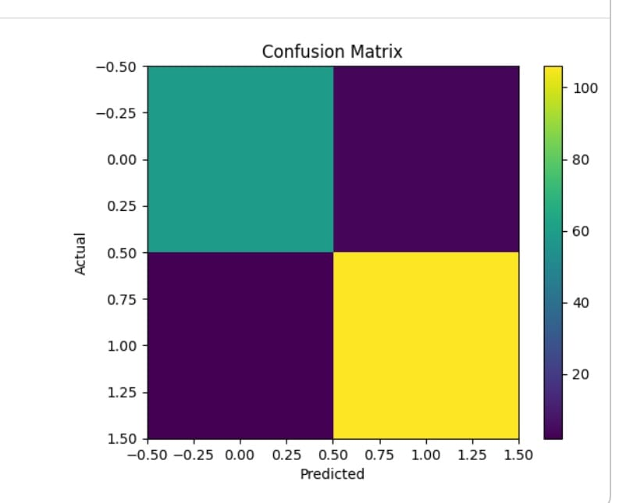
Confusion Matrix
Evaluates model prediction performance
Results (Random Forest):
True Positives → 106
True Negatives → 59
False Positives → 4
False Negatives → 2
Confusion Matrix of Final Model

Slide 19
Best Model
Random Forest
Achieved high and stable accuracy
Performed well on both training and testing data
Handles complex feature relationships effectively
Provides feature importance for better understanding

Slide 20
Future scope
Build a deep-learning model on sensor data (pressure, temp, vibration) for real-time fault prediction.
Deploy it as a real-time alert service on the shop floor (edge + dashboard).
Integrate IoT sensors across all critical machines for continuous monitoring and auto-retraining of the model.

Slide 21
Appendix:
Code snippet:
python import pandas as pd
df = pd.read_csv('machine_data.csv')
df['fault_rate'] = df.faults / df.cycles
Extra graph: fault rate vs. pressure scatter plot (shows upward trend beyond 220 kPa).

Slide 22
References:
Smith et al., “Predictive Maintenance using Deep Learning,” Journal of Manufacturing Systems, 2023.TensorFlow documentation, tensorflow.org/guide/keras.Company machine manual v2.1 (sensor specs, calibration procedure).

Slide 23
Final Remark
Overall, the model performs well on the dataset.
With proper tuning and feature selection, the prediction accuracy can be further improved.

Slide 24
Conclusion
Built a classification model to predict Pass/Fail outcomes
Performed data cleaning, analysis, and preprocessing for better data quality
Trained and compared multiple models
Applied hyperparameter tuning to improve performance
Random Forest achieved the best overall performance

Slide 25
Thank You

